Slide 1
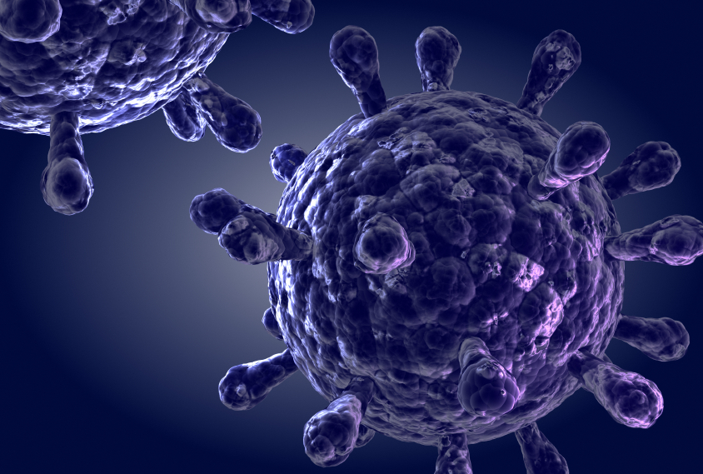
{بِسْمِ اللَّهِ الرَّحْمَنِ الرَّحِيمِ}
INTRODUCTION TO VIRUSES

Slide 2
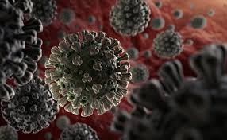
Course Outline
1- History of viruses and viral diseases
2- Propreties of viruses
3- Comparison between viruses and Bacteria
4- Organization and structure of viruses
5- Classification of viruses

Slide 3
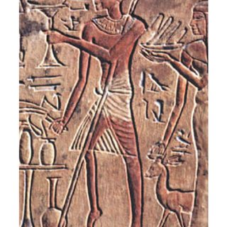

I. History of Viruses and Viral Diseases
Viral diseases have been known for thousands of years (example: rabies)
An Egyptian stele shows us a limping pharaoh, probably affected by polio.
1798: Edward. Jenner : Smallpox vaccination
1885 L. Pasteur : Rabies vaccination
1892 D. Ivanovsky : Discovery of the tobacco mosaic virus (TMV)

Slide 4

1915 Frederick Twort : Discovery of bacterial viruses (bacteriophages)
1939 Invention of the electron microscope and direct observation of viruses (TMV) by G. Kausche, P. Ankuch, H. Ruska

Slide 5

II. Propreties of viruses
Viruses are infectious particles, smaller than bacteria
Viruses are neither Eukaryotic nor Prokaryotic organisms (not cells)
Viruses are obligate intracellular parasites
Viruses lack an independent metabolism
Viral genome is either DNA or RNA but never both.

Slide 6
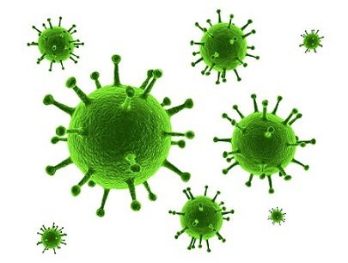
II. Propreties of viruses
Are viruses living or non-living organisms?
Viruses lack their own independent metabolism
Viruses are acellular because they lack a cellular structure.
BUT ‘’’they can multiply inside living cells !!!!!

Slide 7
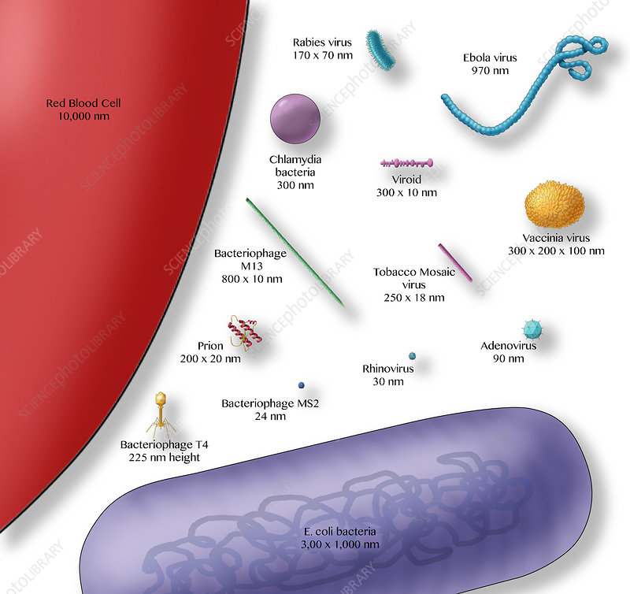
II.1. Size of viruses
Size: 20 - 300 nm,
Viruses are about 100 times smaller than bacteria
Not visible with a light microscope

Slide 8
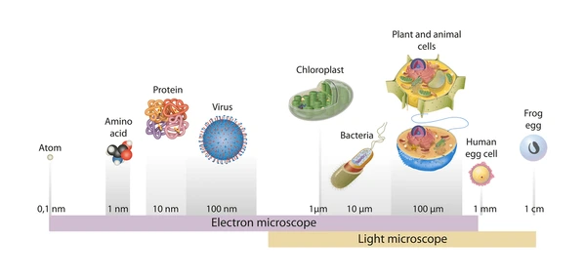
Relative size of particles and cells

Slide 9
Transmission Electron Micrograph showing the size difference between viruses and bacteria
Herpes virus
Bacteria

Slide 10
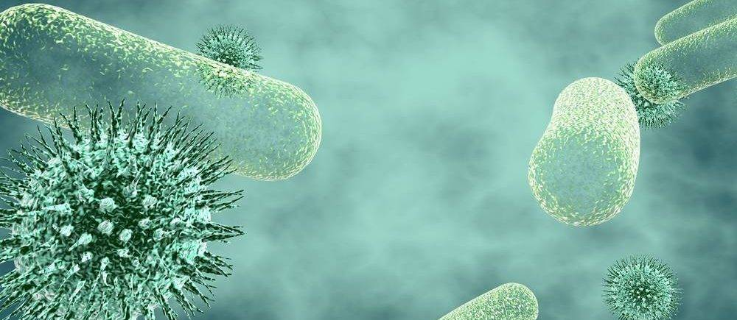
III. The main differences between Bacteria and Viruses
 | Bacteria | Viruses
Size | 0.1 – 10 um | 20-300nm
Metabolism | ++++ | ------
Type of organism | Prokaryotes | Acellular structures
Nucleic acids | DNA and RNA | DNA or RNA
Reproduction | Cell division | Replication of Genetic Material ONLY inside Host Cell (obligate intracellular parasites)
Growth | ++++++ | --------
Microscopic observation | Light and Electron Microscope | Electron Microscope

Slide 11
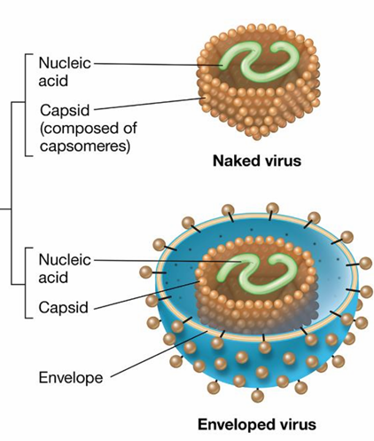
III. Organization and structure of viruses
Viral particle is made up of :
Two constant elements:
a) Genome: (DNA or RNA)
b) Capsid: protein structure
Genome + Capsid = Nucleocapsid
2) One inconstant element:
the envelope (sometimes with a matrix)
Nucleocapsid

Slide 12
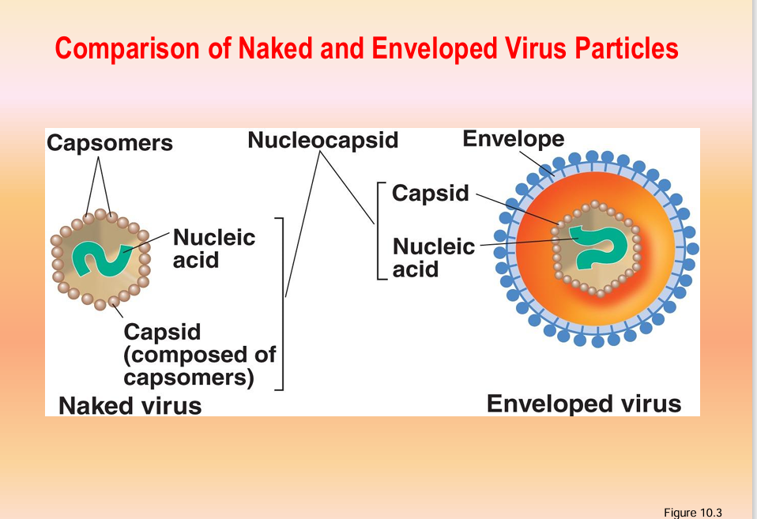
III. Organization and structure of viruses
Non-enveloped virus

Slide 13
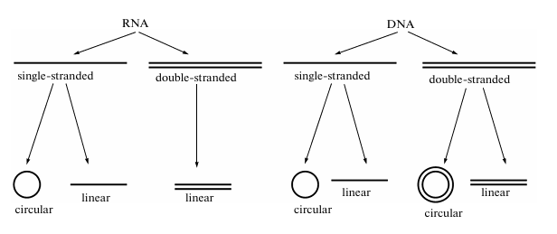
III.1. Viral genome: Shape and structure
Viral Genome
DNA or RNA
Size between 5 to 280 k.bases
Codes for 3 to more than 100 different proteins (structural and non-structural),
Packaged inside protein capsid

Slide 14
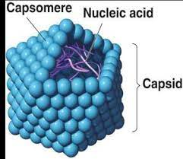
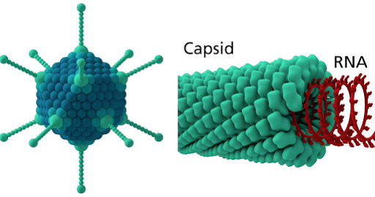
III.2. Viral Capsid
III.2.a. Capsid Structure
Compact protein structure that surrounds the genome.
Made up of protein subunits (capsomeres).
Its main role is the protection of the viral genom
capsomere

Slide 15
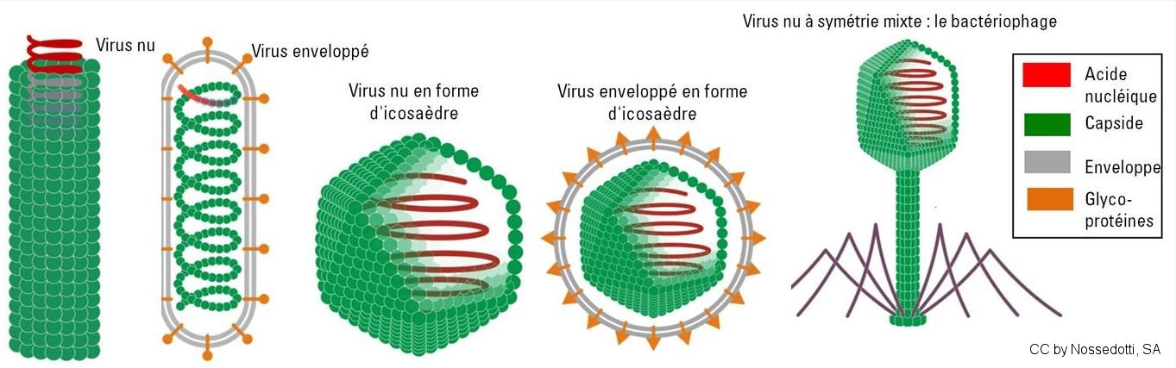
III.2.b. Capsid shapes
envelope
nucleocapsid
Nucleic Acid
Capsid
Envelope
Glyco-proteins
Bacteriophage
Naked virus
Naked virus
Enveloped virus
Enveloped virus
1- Helical symmetry
2- Icosahedral symmetry
3- Complex symmetry

Slide 16
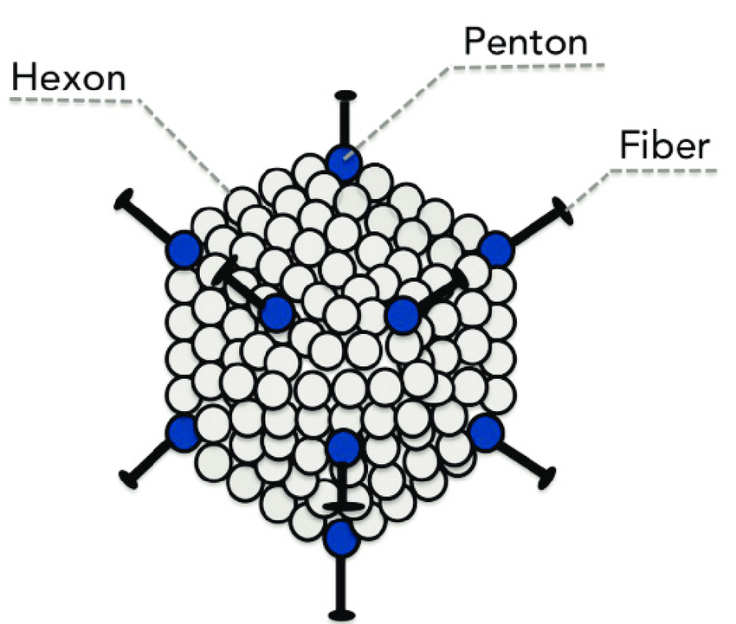
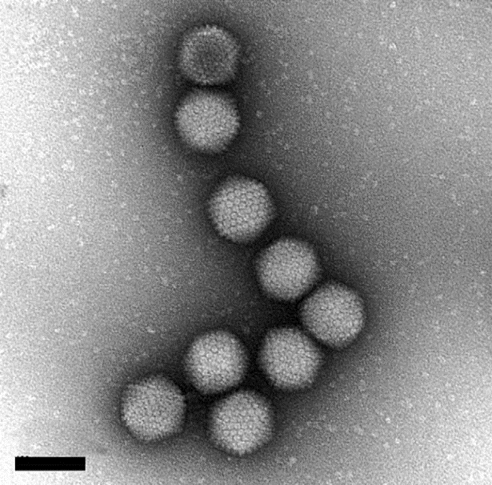
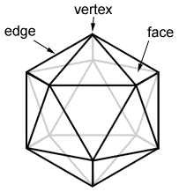
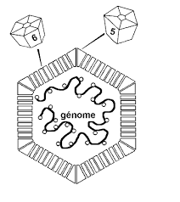
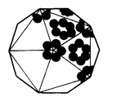
1. Capsid with icosahedral symmetry
C
A
B
Icosahedral capsid: is made up of equilateral triangles with 20 triangular faces, 30 edges, and 12 vertices.
D

Slide 17
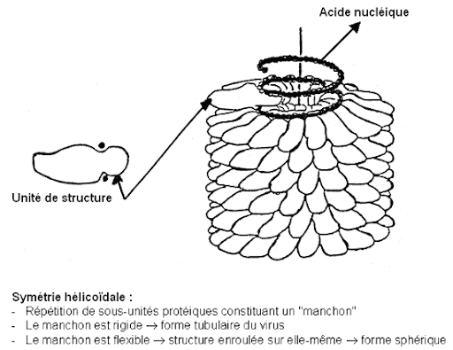
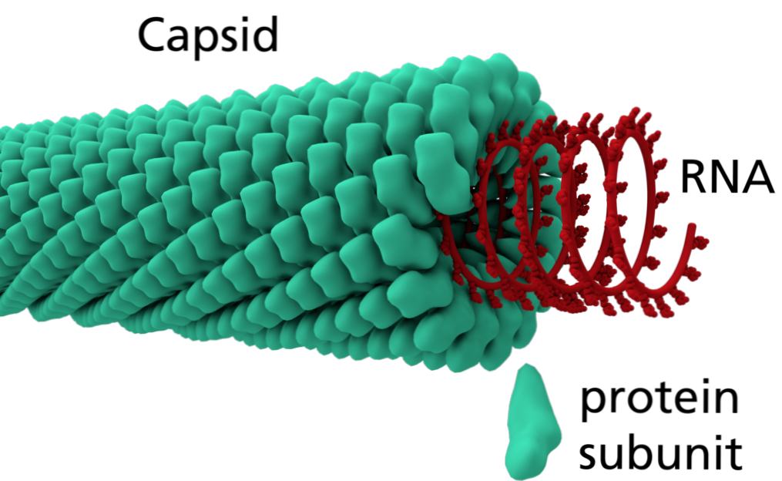
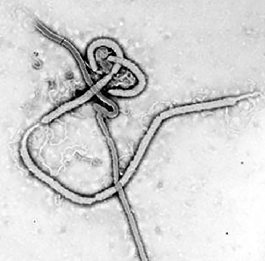
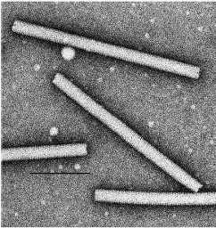
2. Capsid with Helical symmetry
Nucleic acid
B
Protein subunit
A
C
D

Slide 18
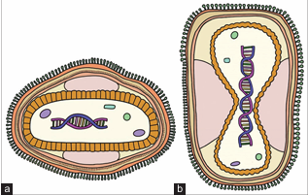
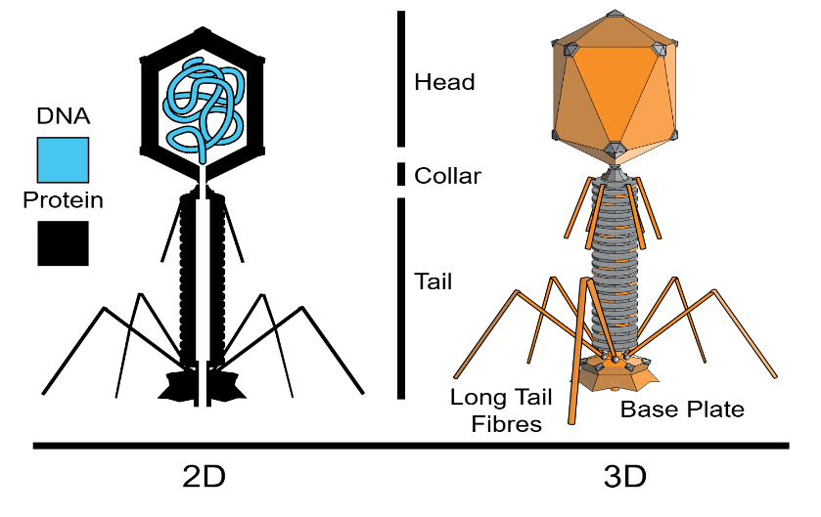
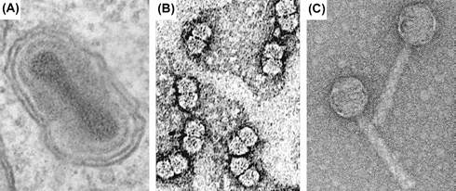
3. Capsid with complex symmery
2
1
Schematic diagram of the poxvirus structure. (a) cross-section; (b) longitudinal section.
T4 Bacteriophage
(A): Vaccinia virus, dumbbell-shaped capsid.
(B): Geminiviruses have a double-icosahedron capsid.
(C) Bacteriophages binal symmetry capsid
3

Slide 19
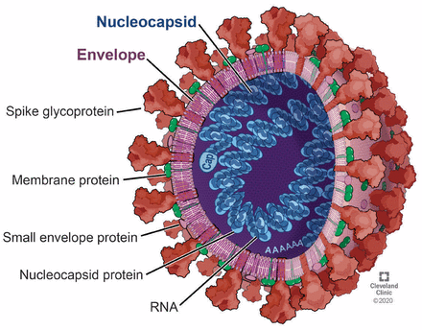
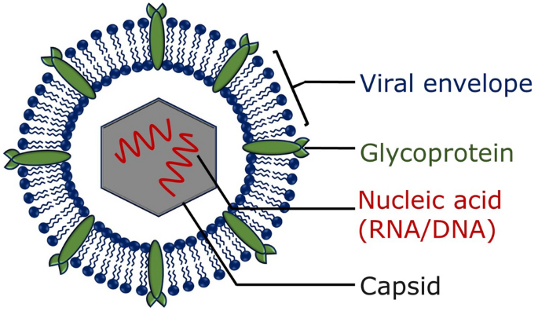
III.3. Viral envelope
Phospholipid double-layer

Slide 20
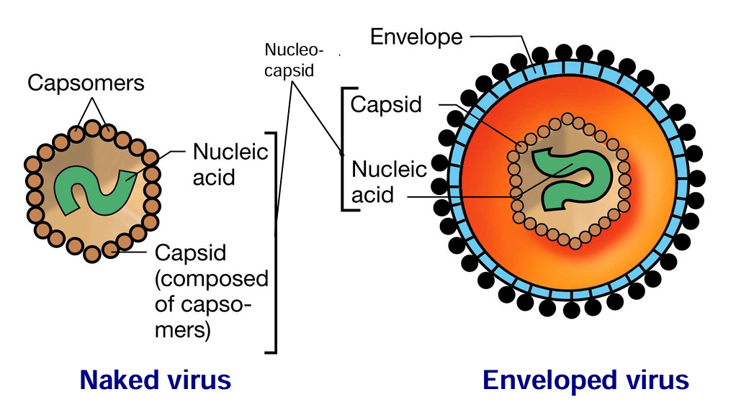

Slide 21
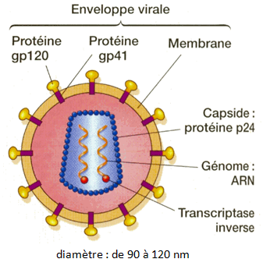
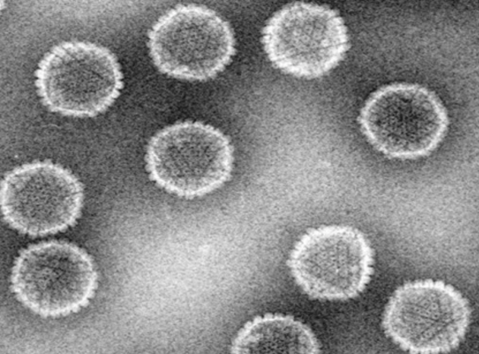
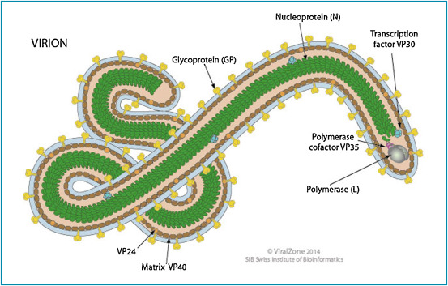
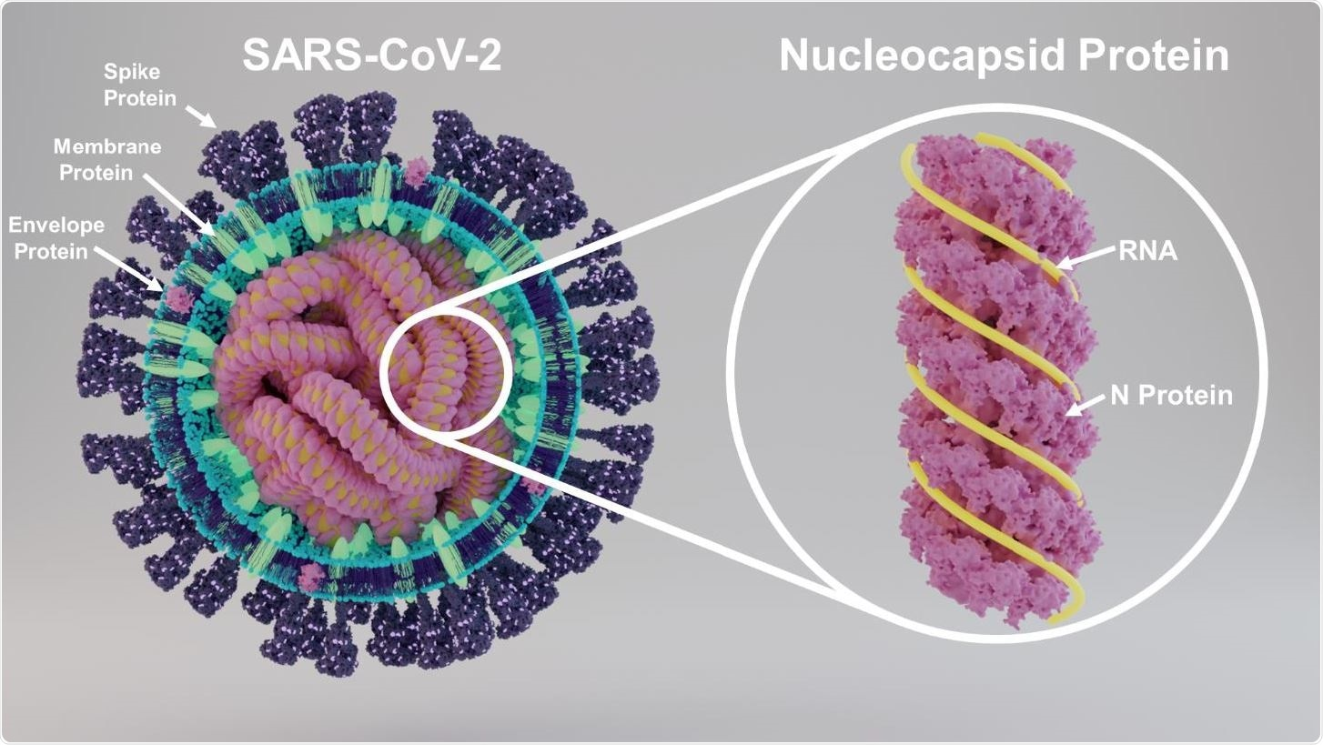
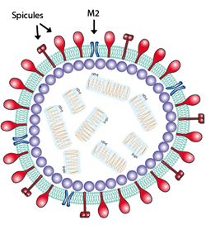
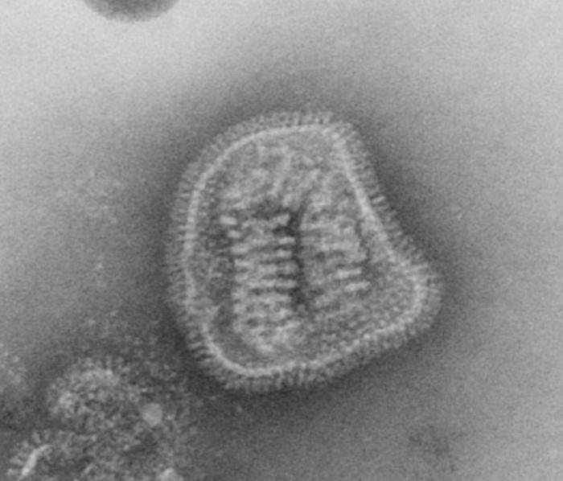
herpès
Ebola
VIH
Influenza
SARS-CoV-2

Slide 22
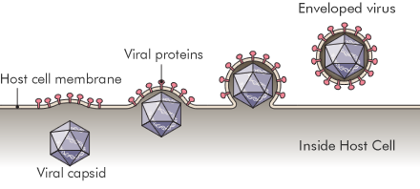
Origin of the viral envelope
Release of virus by budding from the host cell plasma mebmrane. E.g. HIV. And , Measles virus

Slide 23
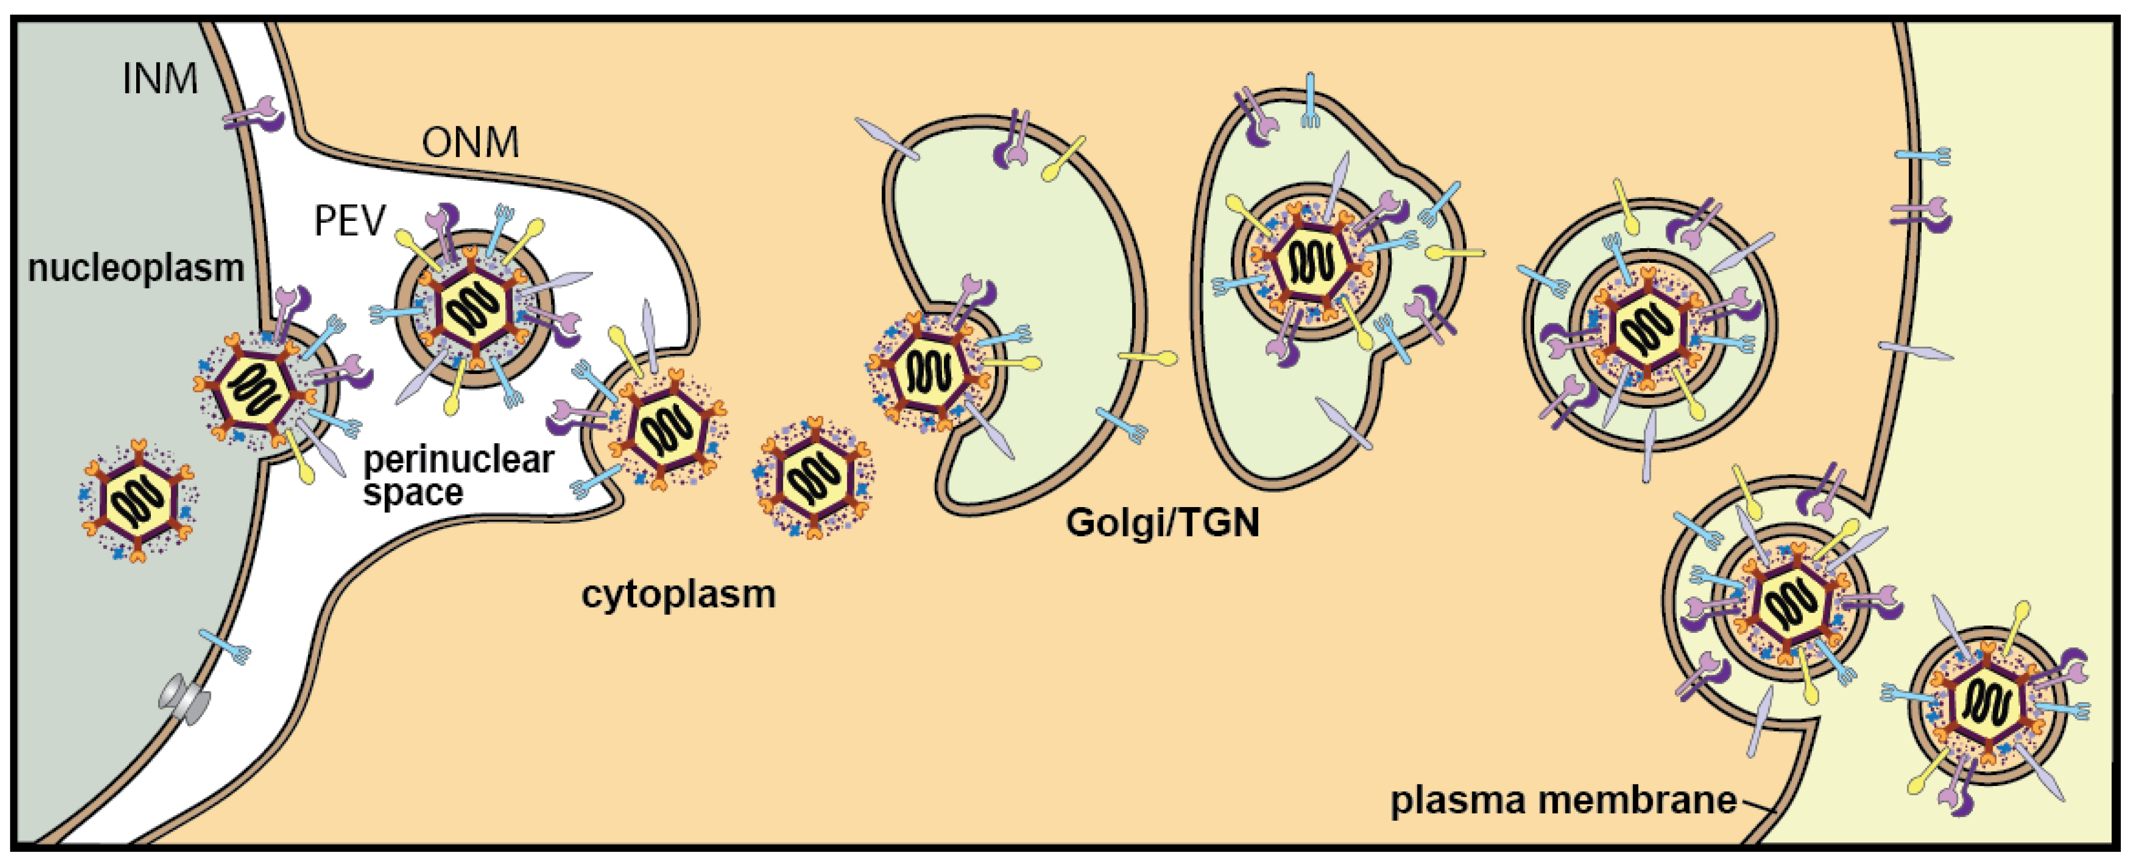
Budding
Exocytosis
Release of virus by budding from TGN than by exocytosis from the host cell membrane. E.g. Herpesvirus,

Slide 24
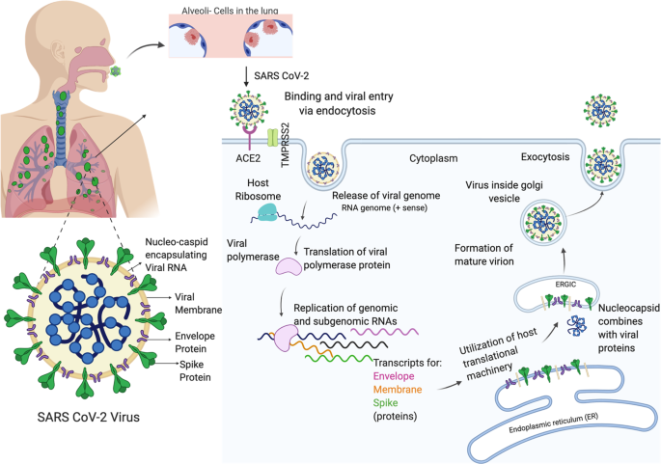
Release of virus by Budding from ER (e.g. SARS CoV2)

Slide 25
Classification of virus
1 - THE GENOME | 2 – THE ENVELOPE | 3 - THE SYMMETRY OF THE CAPSID
1° - The nature of the genetic material - DNA - RNA 2° - The structure of the nucleic acid - Single-stranded - Double-stranded 3° - The shape of the nucleic acid - Linear - Circular - Unsegmented - Segmented | -Naked viruses - Enveloped viruses | - Helical symmetry - Icosahedral symmetry - Unknown symmetry

Slide 26
